Slide 1
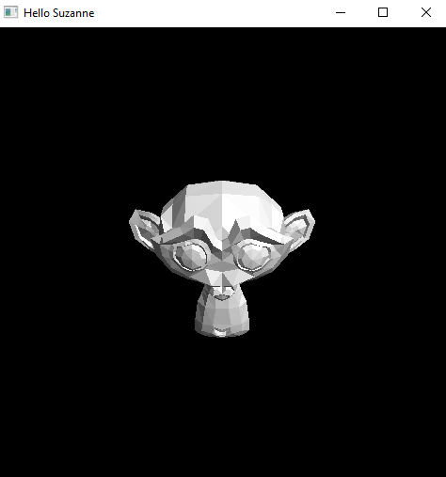
Import OpenGL Geometry from Blender

Slide 2
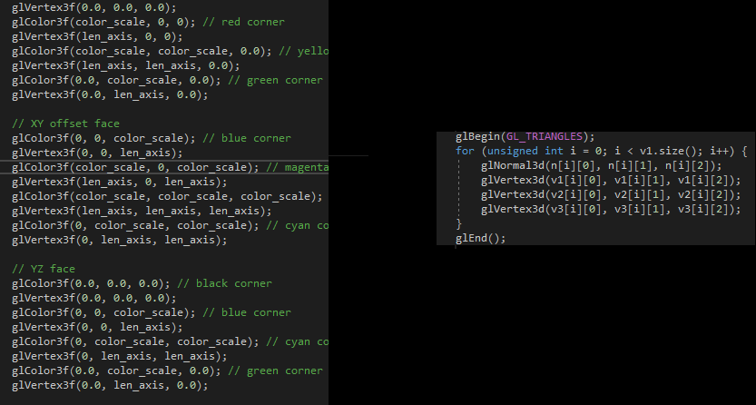
Importing Geometry Makes You Happier

Slide 3
Step 1: Acquire Dependencies
Install the pyntcloud Python module via “pip install pyntcloud”
This module contains a .ply file parser that will come in handy
Source code available at https://github.com/daavoo/pyntcloud
Download json.hpp from https://github.com/nlohmann/json/releases
This is a json file parser for C++
Source code available from https://github.com/nlohmann/json

Slide 4
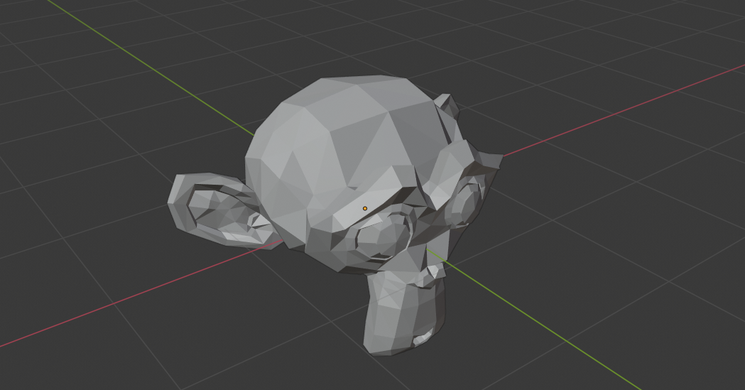
Step 2: Create Blender Geometry

Slide 5
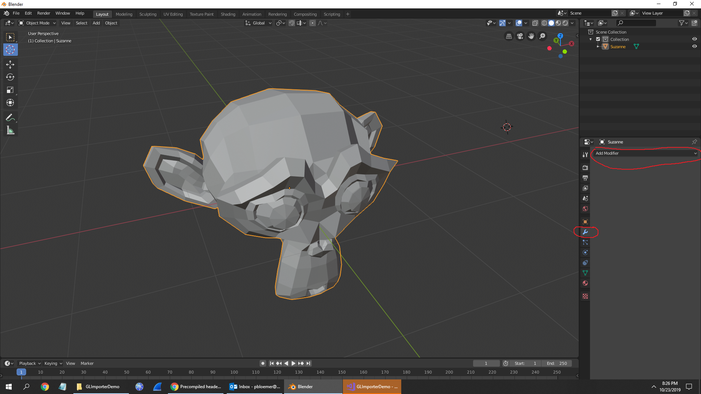
Step 3: Triangulate Blender Mesh

Slide 6
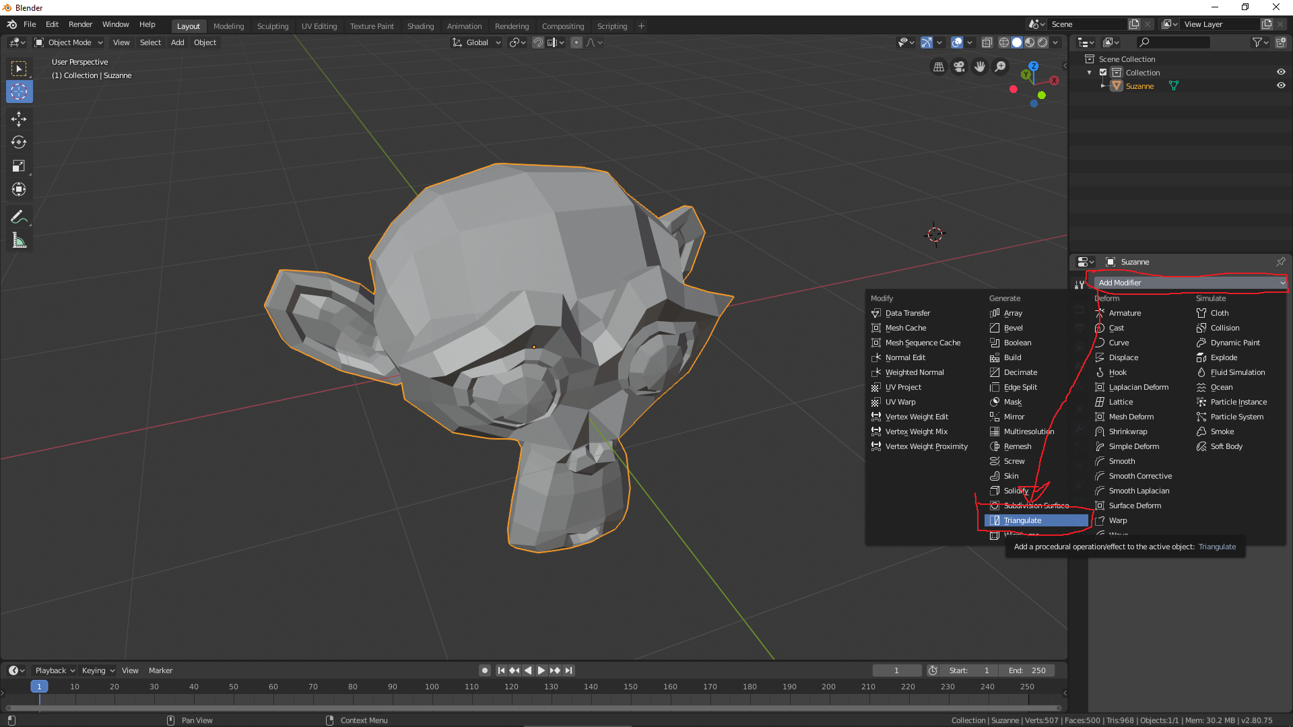

Slide 7
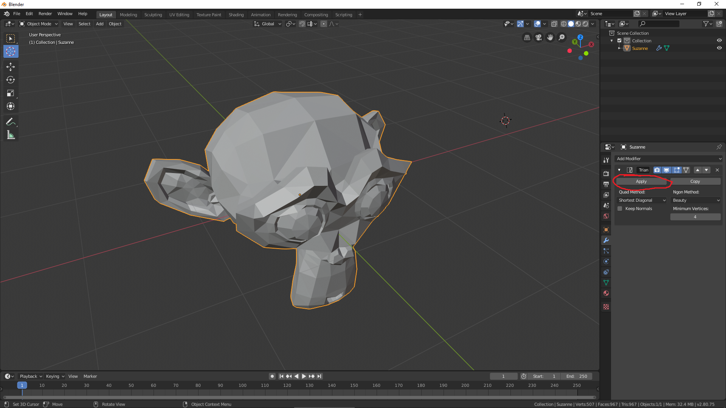

Slide 8
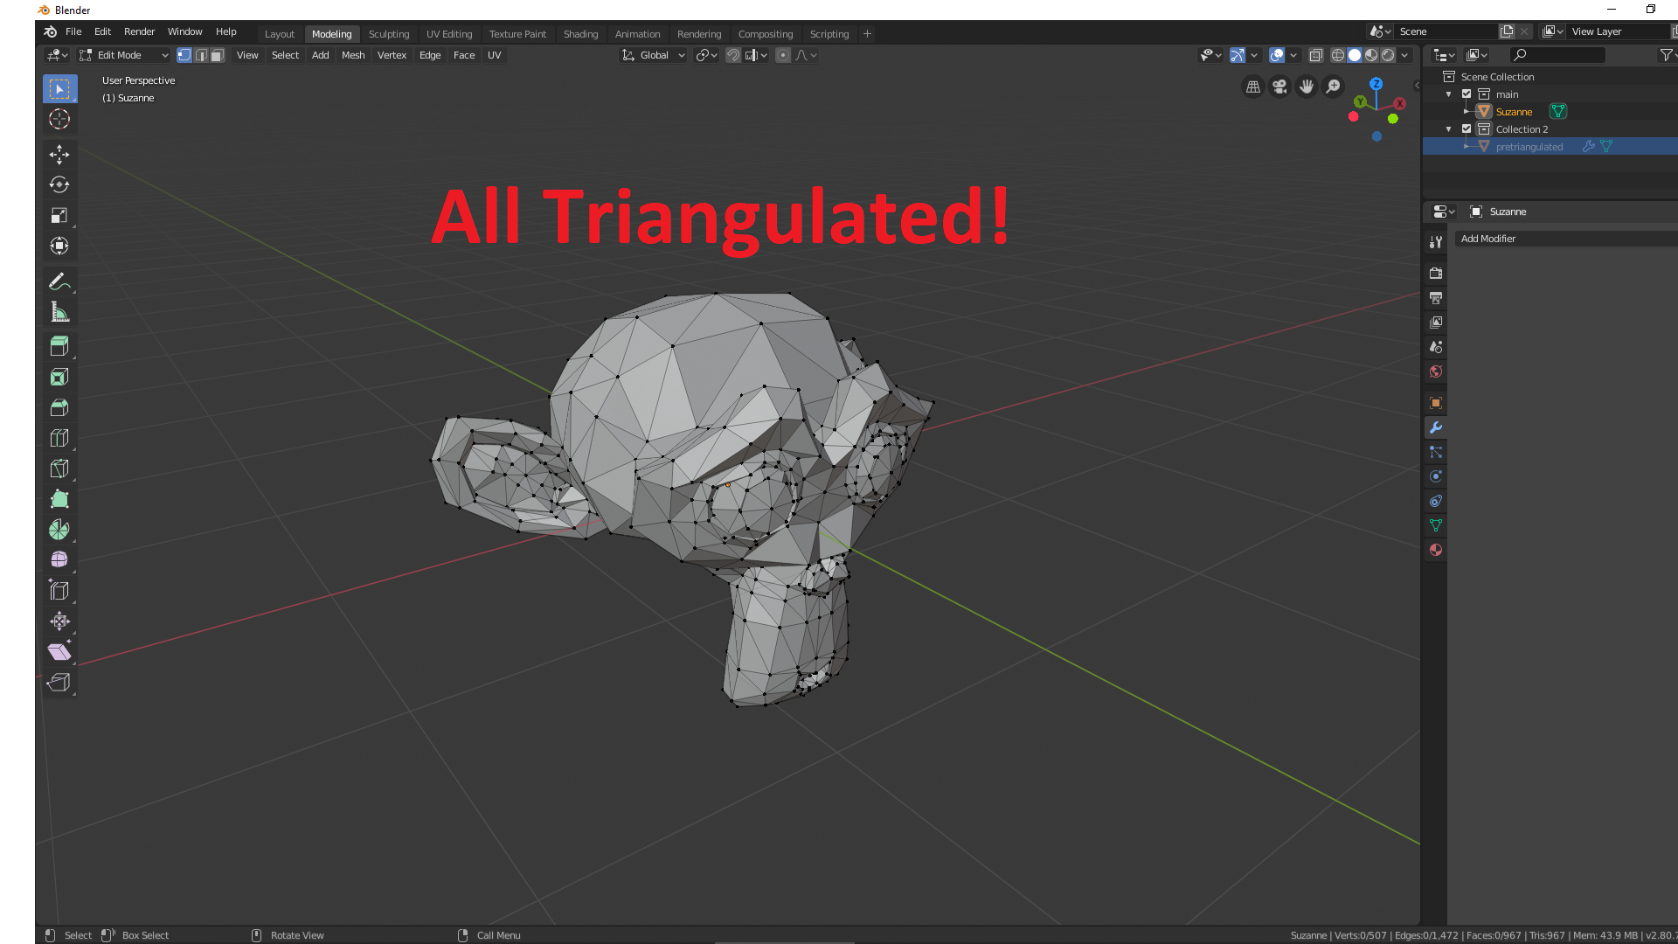

Slide 9
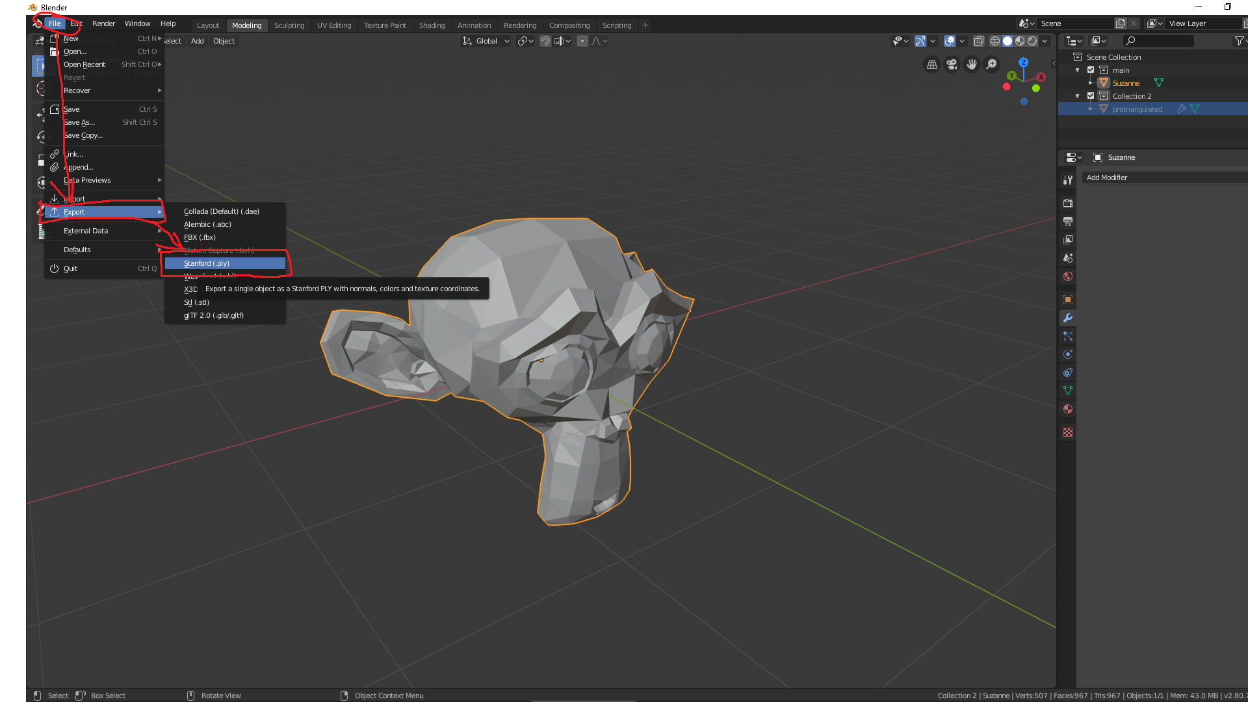
Step 4: Export Geometry as name.ply

Slide 10
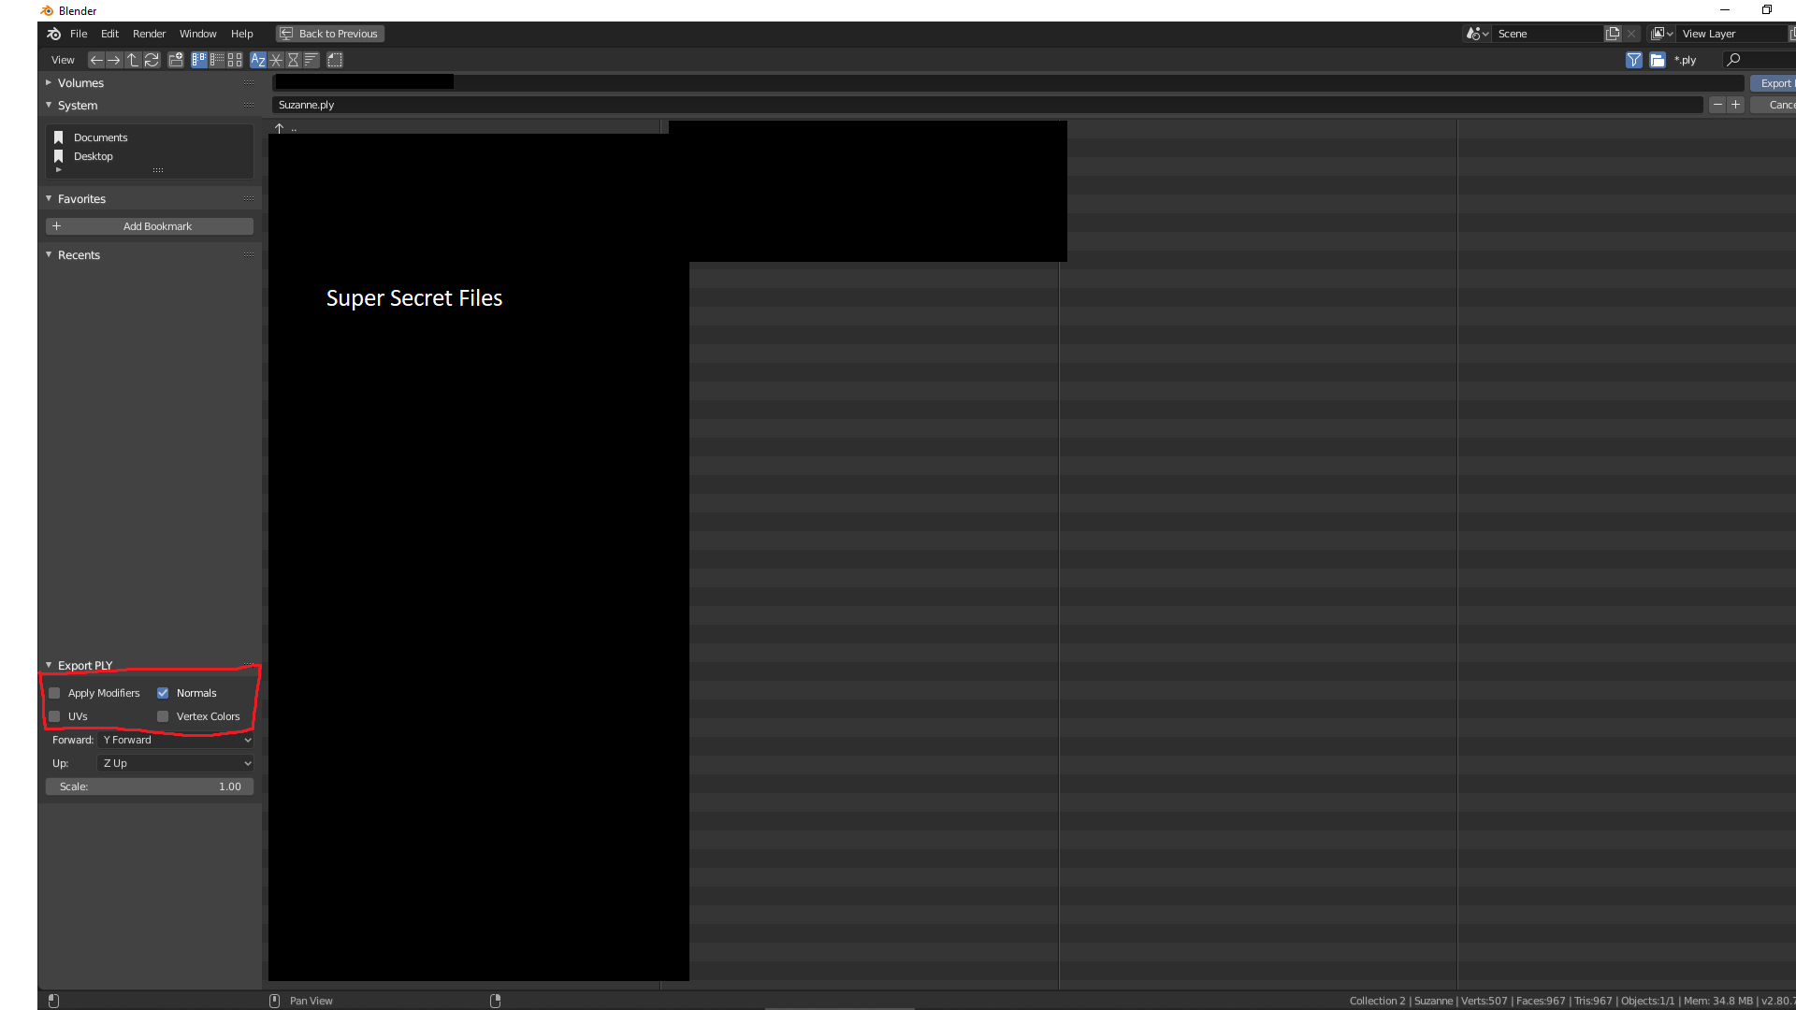

Slide 11
Step 5: Convert model.ply to model.json
Drop ply2json.py (link on last slide) into same folder as model.ply
Run “python ply2json.py model.ply” on command line
You have a model in json form now

Slide 12
Step 5: Import model.json into C++ Program

Slide 13
Contact Info and Github
Email: pbloemer@purdue.edu
Github for demo materials: https://github.com/halitosisman/GLImporter

